Slide 1
The Impact Of COVID-19 On India: A Deep Dive Into The Data
Presenters –
Rushikesh Kharat
Om Mahale
Ankit Vishwakarma
Ayushman Kumar

Slide 2



AGENDA
Introduction
Data Collection And Preprocessing
KPI (Key Performance Indicators)
Key Findings
Implications and Recommendations
Visualizations and Interactive Tools
Conclusion

Slide 3
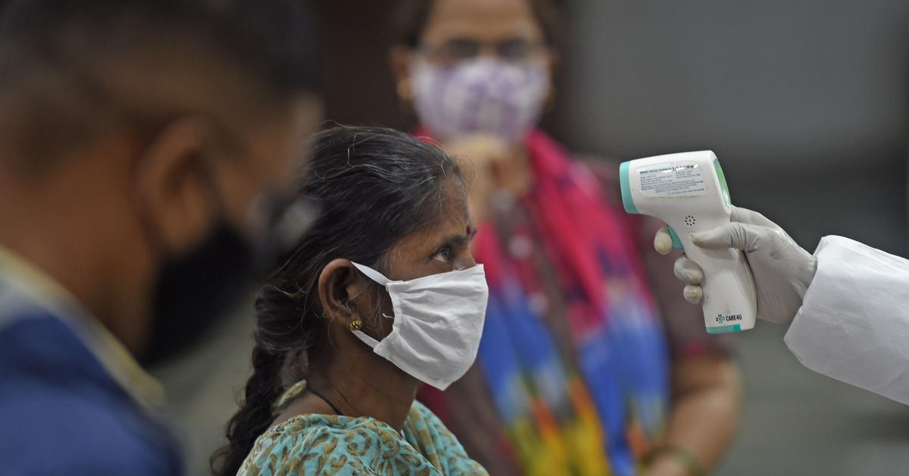
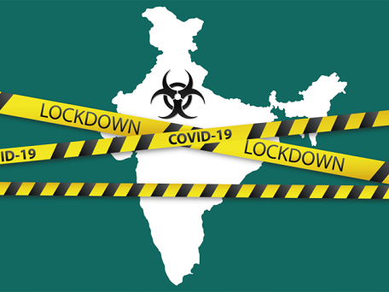

INTRODUCTION
COVID-19 is a highly infectious and potentially deadly respiratory illness caused by the SARS-CoV-2 virus. It Originated from Wuhan ,China.
The COVID-19 pandemic has had a significant impact on India, affecting every aspect of life, from healthcare to the economy.
To better understand the pandemic's impact and help organizations make informed decisions, we conducted a data analysis project on COVID-19 in India.
Through this analysis, we aim to provide insights into the patterns and trends of the pandemic in India, and to identify potential implications for different sectors, such as healthcare, retail, travel, and investment.
Our goal is to help organizations drive their business decisions by leveraging data-driven insights and evidence-based strategies.
This Photo by Unknown Author is licensed under CC BY-NC-ND

Slide 4

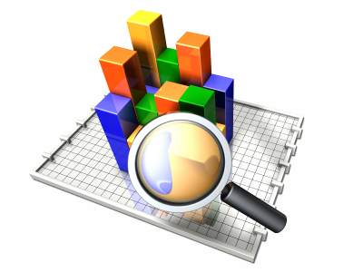

Data Collection And Pre-Processing
DATA COLLECTION METHODS USED
PANDAS
SQL
Requests module
To arrange data according to weeks,months
To calculate Kpi’s
Required Aggregations.
Json module
Json.loads
json_normalize
Json.explode to flatten
Pandas.to_csv
Data Cleaning

Slide 5
Performance Metrics Overview (KPIs)
KPI
Testing Ratio
Case Fatality Rate
Recovery Rate
Case Fatality Rate = (Total number of deaths from COVID-19 / Total number of confirmed cases of COVID-19) x 100
Recovery rate = (Total number of recoveries from COVID-19 / Total number of confirmed cases of COVID-19) x 100
Testing Ratio(tr) = (number of tests done) / (population)

Slide 6
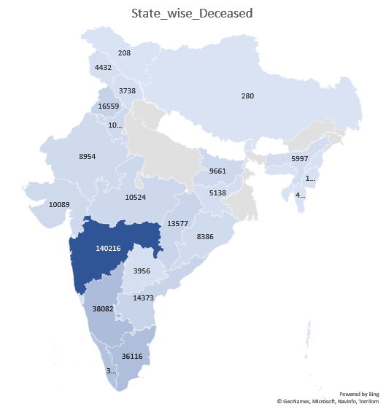
KEY FINDINGS
Highest Positive cases of covid-19 were found in October-2021 but the recovered cases were also increasing due to vaccinations by the end of 2021.
Increased Positive cases resulted in an increased death rate.
After October 2021, no. of cases decreased and so the no. of death.
Cases kept on increasing in 2021 even after the vaccination was started in January 2021.
Finally, during Nov,2021 cases dropped significantly and so the deaths.

Slide 7
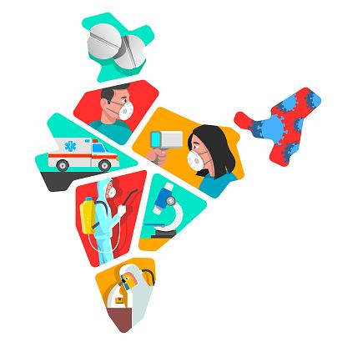
Implications and Recommendations
The pandemic has significantly impacted different industries and sectors, such as travel, hospitality, retail, and e-commerce.
Companies need to adapt to the changing market and consumer behavior, and leverage digital technologies to enhance their services and products. Also explore these opportunities and invest in innovative solutions that can address the current and future challenges of the pandemic.
Organizations and individuals can leverage data and analytics to make informed decisions and mitigate the risks and uncertainties of the pandemic.
Individuals can use data and digital tools to monitor their health and wellbeing, such as wearables and telemedicine services
Data-driven strategies also require strong data governance and ethics, such as ensuring data privacy and security, and avoiding bias and discrimination in data analysis and decision-making.

Slide 8
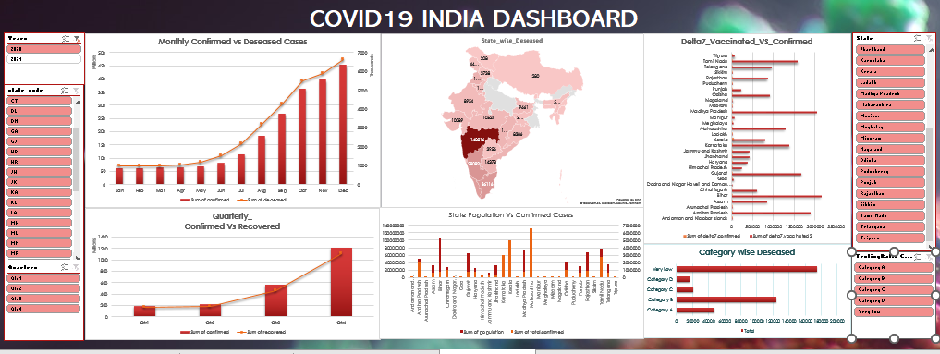
Visualizations and Interactive Tools

Slide 9

Conclusion
In conclusion, the analysis of COVID-19 data has shown the widespread impact that this pandemic.
The number of cases and deaths in India was high, and the healthcare system faced significant challenges in managing the pandemic's impact. However, the Indian government and healthcare professionals implemented various measures to control the spread of the virus, such as lockdowns, increased testing, and vaccination campaigns. These measures appear to have contributed to a decline in cases in the later months of 2021.
Through this analysis, it is clear that the COVID-19 pandemic has posed unprecedented challenges to healthcare systems, economies, and social structures. However, it has also brought about innovation, resilience, and solidarity in the face of adversity.
It's essential to note that COVID-19 is an ongoing global health crisis, and new data and trends may emerge that could impact previous conclusions. Therefore, it's important to continue monitoring the situation and analyzing data to make informed decisions and take appropriate actions to combat the pandemic's effects.

Slide 10
THANK YOU

